Slide 1

STUDENT RESULT MANAGEMENT SYSTEM
By
N. Ravi Teja Reddy
(192210667)

Slide 2

Abstract
In an educational setting, managing student results effectively plays a crucial role in maintaining a smooth academic workflow. A well-organized approach helps ensure that all data is easily accessible, accurate, and up-to-date.
Having a centralized system for handling student records makes it simple to track academic progress, generate reports, and evaluate performance without unnecessary delays or complications.
Automating repetitive tasks like calculating grades and preparing result sheets significantly reduces manual errors while saving time for both educators and administrators.
Presenting results in a clear, transparent, and easy-to-understand format fosters better communication among students, parents, and faculty, creating a more supportive academic environment.
Ensuring data security and scalability is vital for protecting sensitive information while preparing to handle the growing needs of institutions as they expand over time.

Slide 3

Introduction
Managing student results is essential for accurately and consistently tracking academic performance. It involves more than just recording grades, encompassing a broader range of student achievements and providing a comprehensive view of their academic progress.
A well-organized result management system ensures that data is presented in a clear, accessible, and meaningful way, making it easy for students, teachers, and parents to understand and use.
Automating repetitive tasks within the result management system helps reduce human errors and saves valuable time, enabling teachers and administrators to focus on enhancing student learning and other critical educational activities.
Transparent result systems facilitate better communication between educators, students, and parents, ensuring that stakeholders can easily access performance data and make informed decisions regarding academic support and progress.
A secure and adaptable result management system not only safeguards sensitive student data but also ensures scalability, allowing institutions to grow and evolve while maintaining the integrity and confidentiality of academic records.

Slide 4
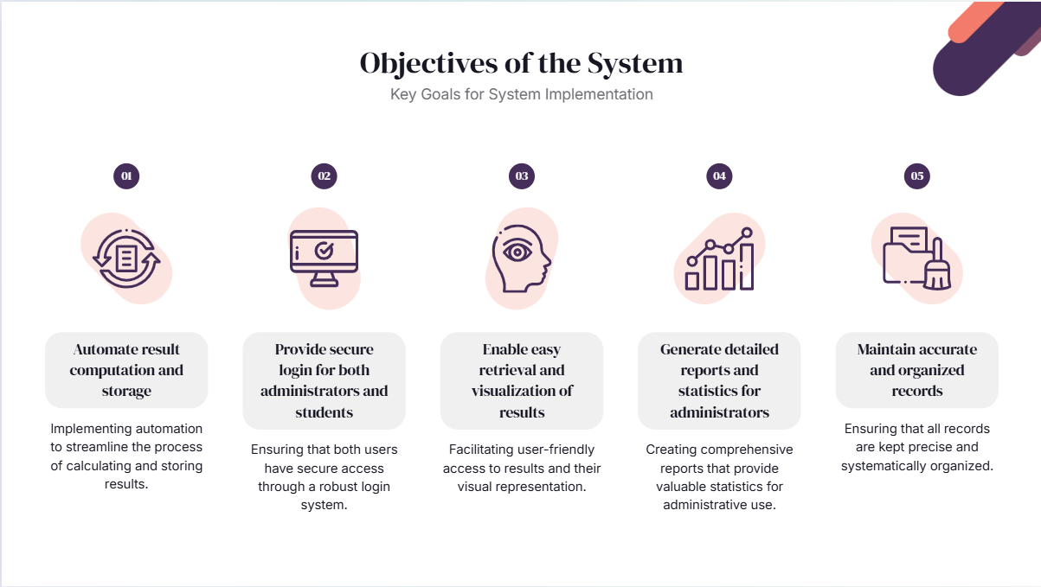

Slide 5
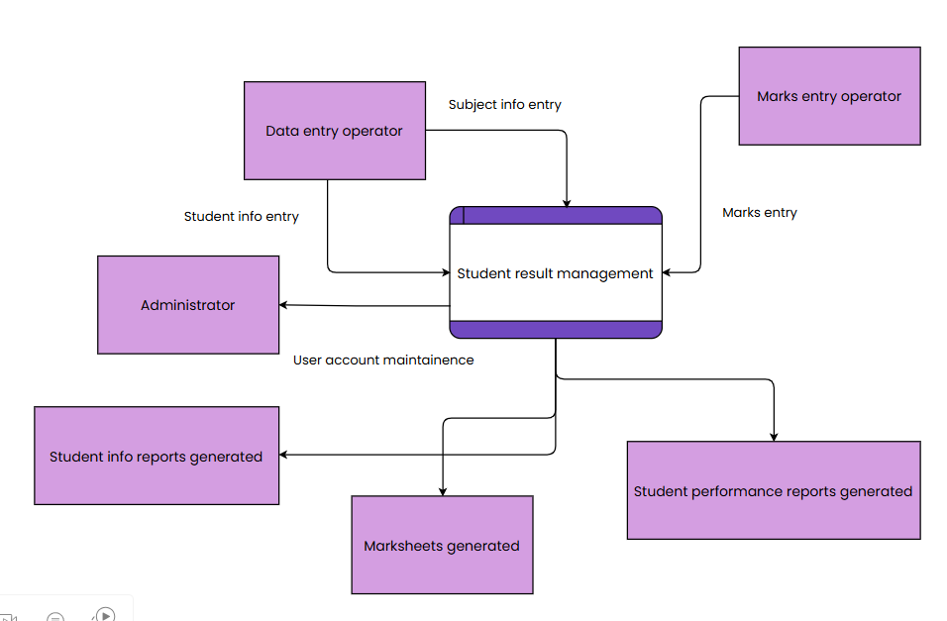

Design

Slide 6
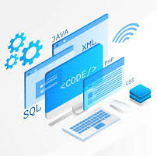
Implementation
programming
Python
Python offers simplicity and flexibility, making it ideal for backend logic, especially when paired with frameworks like Django or Flask.

Slide 7



programming
frontend
backend
framework
Python
Python offers simplicity and flexibility, making it ideal for backend logic, especially when paired with frameworks like Django or Flask.
HTML, CSS, JavaScript
These are essential for building responsive and user-friendly web pages, allowing the system to be accessible on various devices.
Django
Django provides a robust, secure, and scalable structure for building web applications, with built-in features like authentication, database ORM, and admin interfaces.
MySQL
MySQL is a reliable and widely-used relational database, which helps store and manage large datasets like student records and exam scores efficiently.

Slide 8

Advantages and Disadvantages

Slide 9
Advantages
Limitations
Automates the process of calculating and managing student results, saving significant time compared to manual methods.
Reduces human error in grading and result calculation, ensuring accuracy in the final results.
Provides secure access for both students and administrators, protecting sensitive data such as grades and personal information.
Organizes and stores student records and grades in a centralized system, making it easier to retrieve data when needed.
Enables real-time result generation, allowing students to view their results immediately after exams.
The system relies heavily on technology, which means any technical issues (e.g., server outages or system failures) can disrupt access to results.
The initial setup of the system can be costly, including expenses for software development, infrastructure, and integration.
Smaller institutions with fewer students may find the system too complex or unnecessary.
There is always the risk of security vulnerabilities in the system, which could lead to unauthorized access to sensitive data.
Training is required for both administrators and students to ensure they can use the system properly, which can be time-consuming.

Slide 10




Key Features
Admin Panel Functionality
Student Dashboard Access
Graphical Analysis
Secure Database Integration
Allows administrators to add, edit, and delete student details, input and update scores, and generate and publish results.
Enables students to securely view their individual results and download result reports.
Provides graphical analysis of results for better understanding and insights.
Ensures a secure database integration to protect sensitive student information.

Slide 11
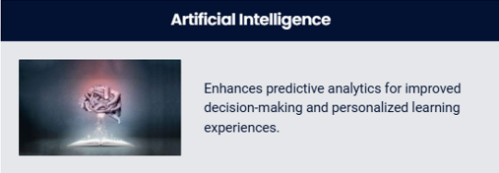
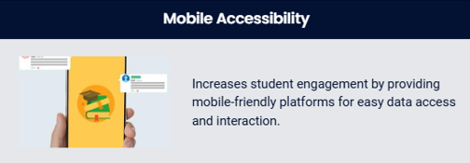


Future Trends

Slide 12
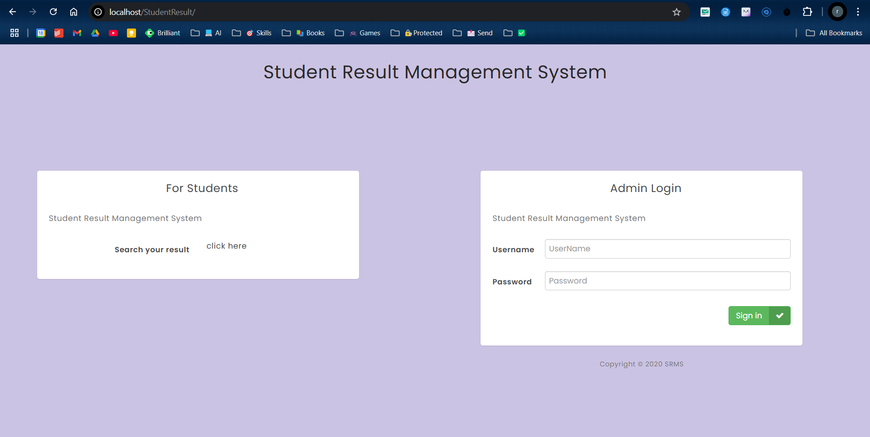
User Interface

Slide 13
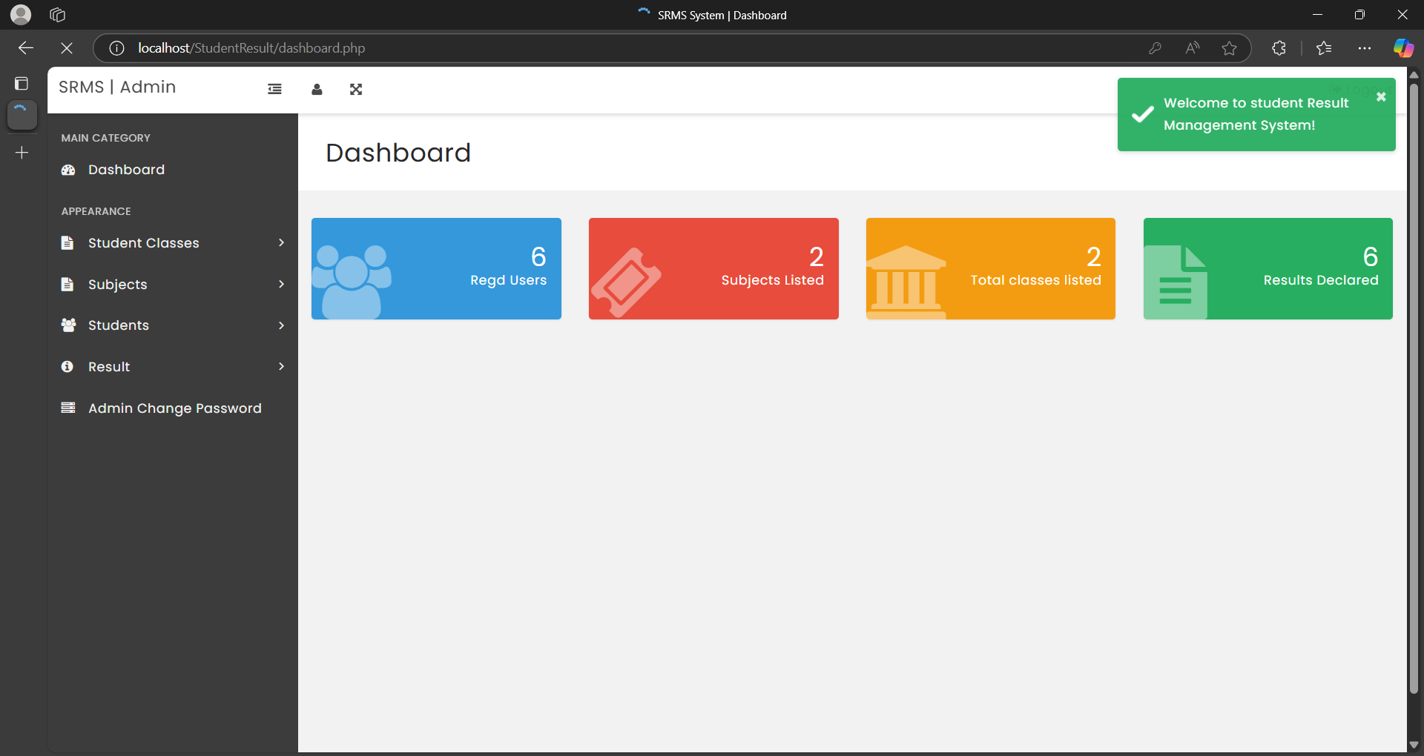
Dashboard

Slide 14
Conclusion
The Student Result Management System effectively streamlines the management of student data and academic results. By combining Python (Flask) for backend development, MySQL for database management, and a responsive HTML/CSS/JavaScript frontend, the system offers an intuitive and efficient platform for administrators. The user-friendly interface allows easy input of student details and result data, while the backend handles data processing seamlessly.
The project successfully meets its goal of simplifying administrative tasks and ensuring accurate record-keeping. With Bootstrap enhancing the UI design, the system is both modern and responsive across devices. Overall, this project showcases the potential of combining contemporary web technologies to create practical solutions in education, providing a solid foundation for future enhancements such as advanced reporting features and user authentication.

Slide 15


